Slide 1

Cardiologist-Level Arrhythmia Detection with Convolutional Neural Networks
- Pranav Rajpurkar, Awni Y. Hannun -
Jae-min, Lee
ashesmin@mobile.re.kr
Intelligence Networking & Computing Lab.
Dept. of Electrical & Computer Eng.
Pusan National University

Slide 2
Contents
Introduction
Data
Model
Structure
Convolutional Layer
Relu
Dropout
Batch Normalization
Shortcut connections
Analysis
Intelligence Networking and Computing Lab.

Slide 3
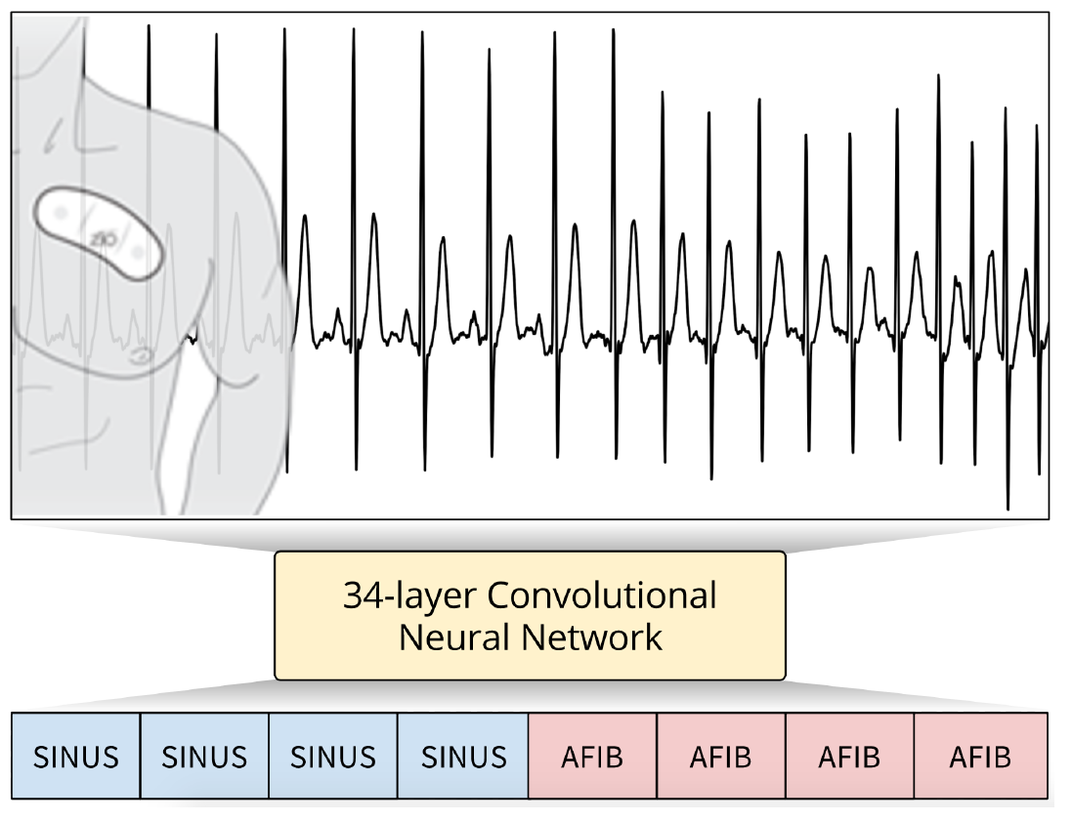
Introduction
Diagnosing arrhythmias
Detecting arrhythmias from ECG records has traditionally been challenging for computer systems, with accuracy rates ranging from 50% to just 1 in 7 correct diagnoses
34-layer Convolutional Neural Network(CNN)
Single-lead ECG signal sampled at 200Hz and a sequence of annotations for every second of the ECG
Residual connections and batch-normalization
A dataset of about 30,000 unique patients
from a pool of nearly 300,000 patients who have used the Zio Patch monitor(iRhythm Technologies)
Testing model against board-certified cardiologists
The model exceeds the individual expert performance on both recall, and precision on this test set
- SINUS : The sinus rhythm
- AFIB : Atrial fibrillation(심방 세동)
Intelligence Networking and Computing Lab.

Slide 4
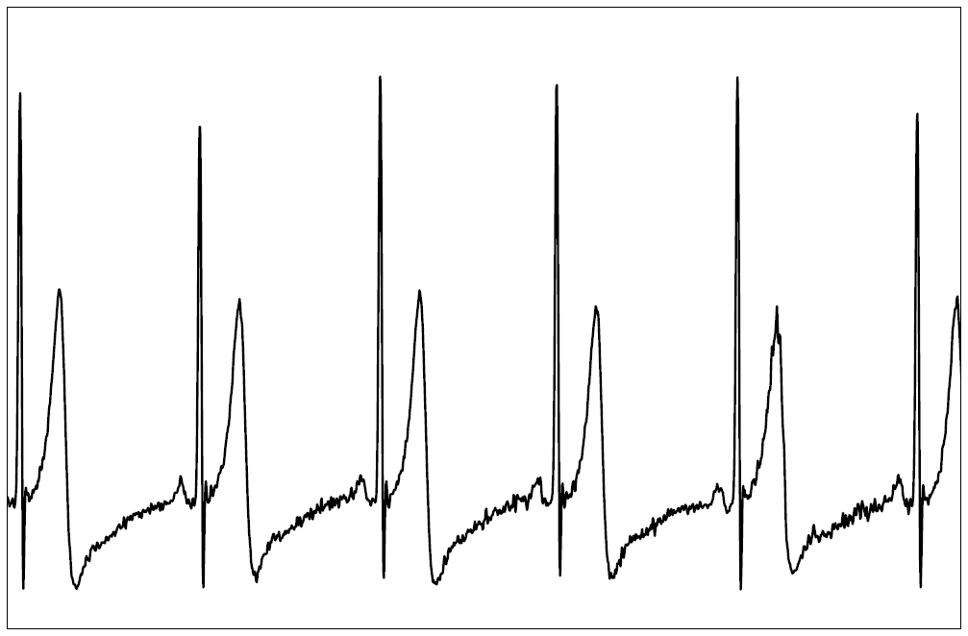
Data
A single-lead ECG signal sampled at 200Hz and a sequence of annotations for every second of the ECG
A ECG record = 30 seconds ECG signal
Rhythm Classes
14 output classes : 12 heart arrhythmias, sinus rhythm and noise
Training Data
64,121 ECG records from 29,163 patients.
90% Training set and 10% validation set
Test Data
336 ECG records from 328 patients.
Intelligence Networking and Computing Lab.

Slide 5
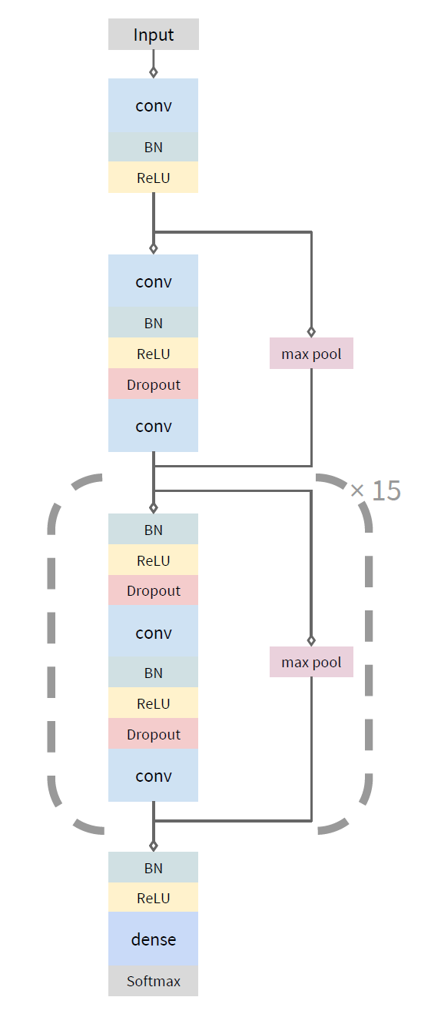
Model
Structure
The convolutional layers all have a filter length of 16 and have 64k filters, where k starts out as 1 and is incremented every 4-th residual block
Every alternate residual block subsamples its inputs by a factor of 2
Intelligence Networking and Computing Lab.

Slide 6
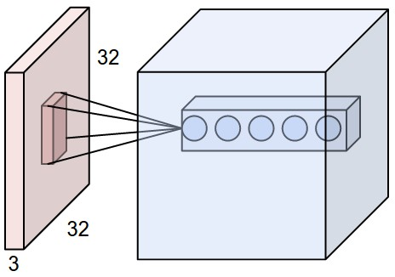
Model
Convolutional Layer
Input ( + padding 1) (7*7*3)
Filter W0(3*3*3)
Filter W1(3*3*3)
Output (3*3*2)
0 | 0 | 0 | 0 | 0 | 0 | 0
0 | 1 | 1 | 1 | 2 | 1 | 0
0 | 2 | 0 | 1 | 0 | 2 | 0
0 | 2 | 2 | 2 | 2 | 2 | 0
0 | 1 | 2 | 1 | 2 | 2 | 0
0 | 0 | 0 | 1 | 2 | 1 | 0
0 | 0 | 0 | 0 | 0 | 0 | 0
x [ : , : , 0]
o [ : , : , 0]
-1 | 0 | -1
1 | 0 | 0
-1 | -1 | -1
w0 [ : , : , 0]
-1 | 1 | 0
0 | 1 | 0
-1 | 1 | 1
w1 [ : , : , 0]
1 | 1 | 2
1 | 2 | 3
-1 | 2 | 5
0 | 0 | 0 | 0 | 0 | 0 | 0
0 | 2 | 0 | 1 | 2 | 0 | 0
0 | 1 | 0 | 2 | 0 | 0 | 0
0 | 0 | 2 | 0 | 2 | 1 | 0
0 | 1 | 2 | 1 | 2 | 2 | 0
0 | 0 | 0 | 1 | 2 | 1 | 0
0 | 0 | 0 | 0 | 0 | 0 | 0
x [ : , : , 0]
0 | 0 | 0
0 | 1 | -1
0 | 0 | -1
w0 [ : , : , 1]
0 | -1 | 1
1 | 1 | 0
0 | 0 | 0
w1 [ : , : , 1]
o [ : , : , 1]
10 | 6 | 5
5 | 3 | 7
3 | 4 | -1
0 | 0 | -1
0 | 0 | 0
1 | 0 | 1
w0 [ : , : , 2]
1 | 0 | 1
0 | 1 | 1
0 | 1 | 1
w1 [ : , : , 2]
0 | 0 | 0 | 0 | 0 | 0 | 0
0 | 2 | 1 | 2 | 0 | 0 | 0
0 | 2 | 0 | 0 | 1 | 0 | 0
0 | 2 | 0 | 1 | 2 | 2 | 0
0 | 0 | 2 | 0 | 0 | 0 | 0
0 | 0 | 1 | 0 | 0 | 1 | 0
0 | 0 | 0 | 0 | 0 | 0 | 0
x [ : , : , 0]
Convolutional Layer
Bias b0(1*1*1)
Bias b1(1*1*1)
1
0
Intelligence Networking and Computing Lab.

Slide 7
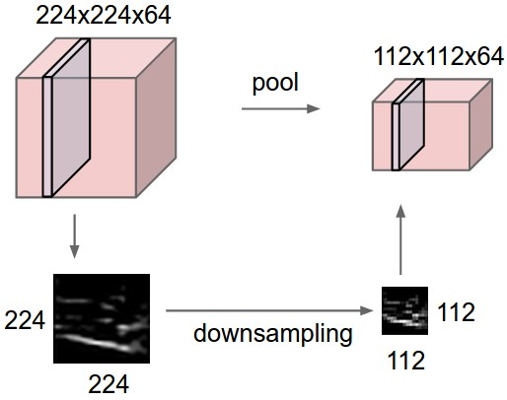
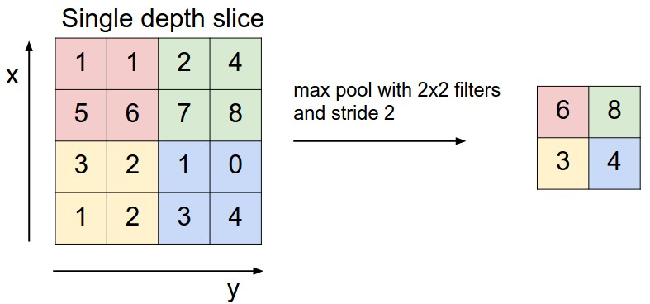
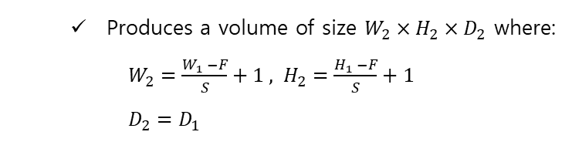
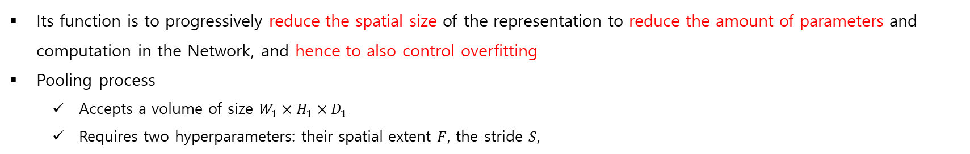
Model
Pooling Layer
Its function is to progressively reduce the spatial size of the representation to reduce the amount of parameters and computation in the Network, and hence to also control overfitting
Pooling process
Accepts a volume of size $W_{1}×H_{1}×D_{1}$
Requires two hyperparameters: their spatial extent $F$, the stride $S$,
Produces a volume of size $W_{2}×H_{2}×D_{2}$ where:
$W_{2}=\frac{W_{1} −F}{S}+1 , H_{2}=\frac{H_{1} −F}{S}+1$
$D_{2}=D_{1}$
Down sampling
Max Pooling
Intelligence Networking and Computing Lab.

Slide 8
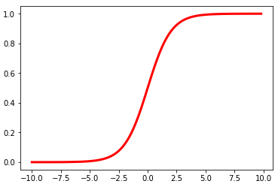
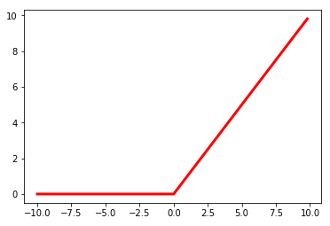
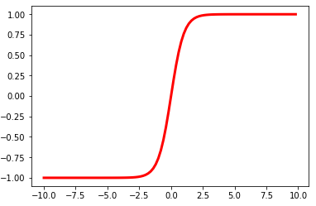



Model
Relu
$$f\left(x\right)=\frac{1}{1+e^{−x}}$$
$$f\left(x\right)=max⁡(0,x)$$
Sigmoid
$f\left(x\right)=tanh⁡(x)$
ReLU
Intelligence Networking and Computing Lab.
tanh

Slide 9
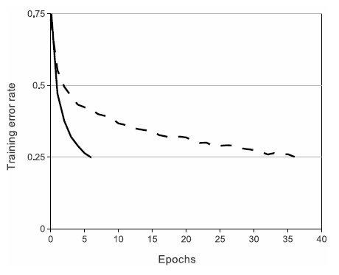
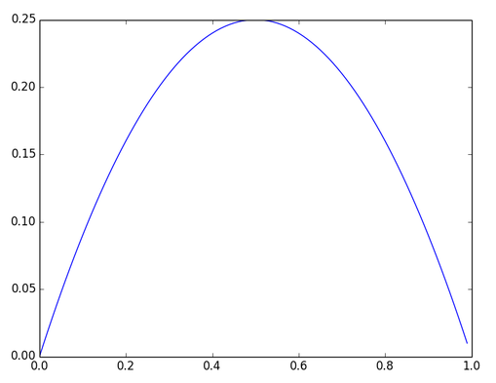
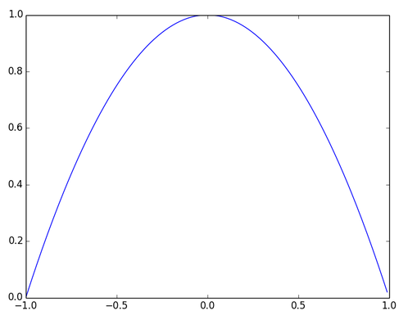
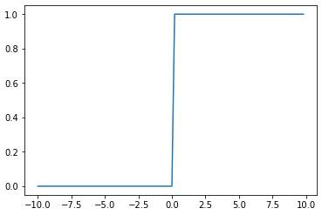
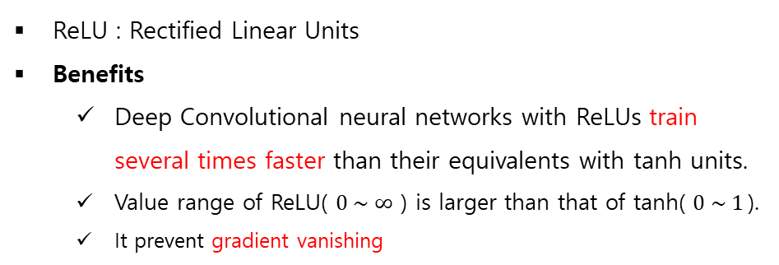
Model
Relu
ReLU : Rectified Linear Units
Benefits
Deep Convolutional neural networks with ReLUs train several times faster than their equivalents with tanh units.
Value range of ReLU( $0 \sim ∞$ ) is larger than that of tanh( $0 \sim 1$).
It prevent gradient vanishing
Dataset : Cifar10
Architecture :
four-layer CNN
Solid line : ReLU
Dashed line : tanh
※ Gradient Vanishing
6 times faster!
Sigmoid derivative
tanh derivative
ReLU derivative
Intelligence Networking and Computing Lab.

Slide 10
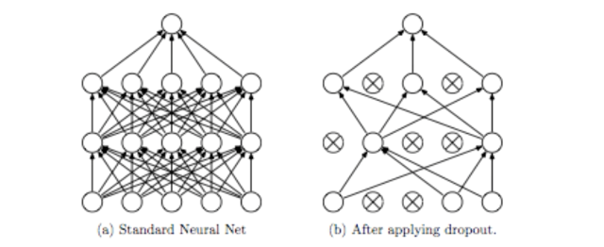
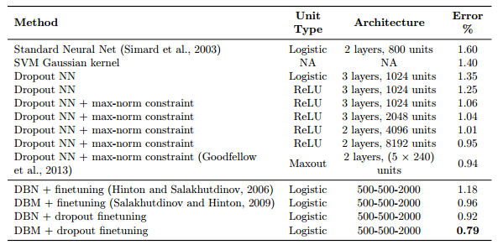
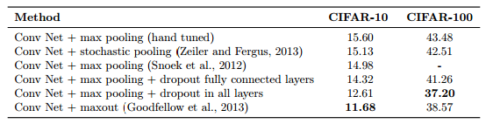
Model
Dropout
“사공이 많으면 배가 산으로 간다.”
Randomly set some neurons to zero in the forward pass
Error rates on CIFAR-10 and CIFAR-100
Comparison of different models on MNIST
Intelligence Networking and Computing Lab.

Slide 11
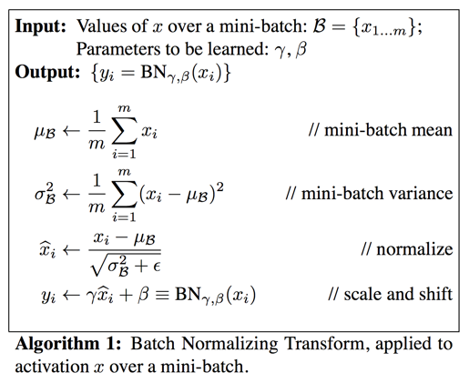













Model
Batch Normalization
When batch normalization is used, it is not affected by scale
$$O$$
$$O$$
$$O$$
$$H_{3}$$
$$H_{3}$$
$$H_{3}$$
$$H_{2}$$
$$H_{2}$$
$$H_{2}$$
train2
$$H_{1}$$
$$H_{1}$$
$$H_{1}$$
train1
Internal Covariate Shift
$$x$$
Intelligence Networking and Computing Lab.

Slide 12
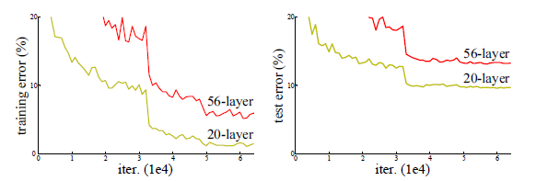
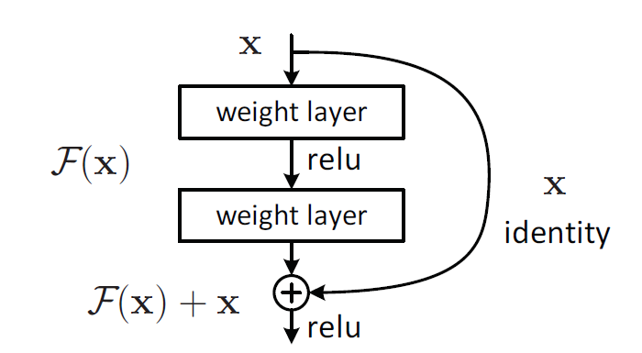
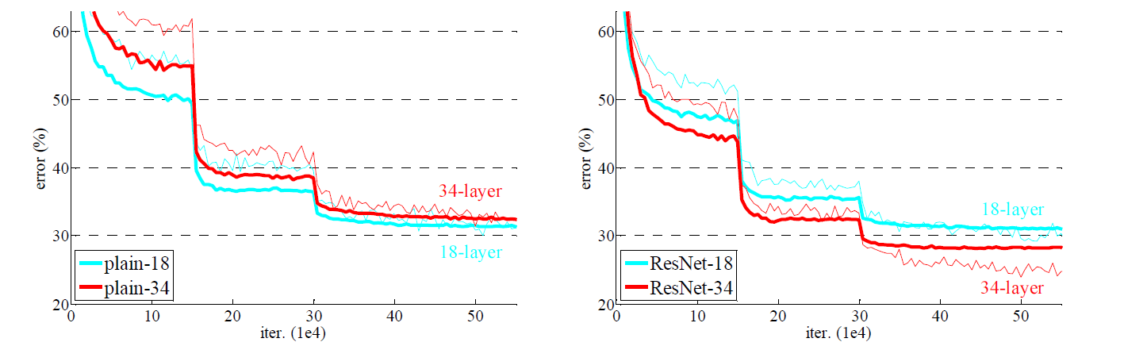
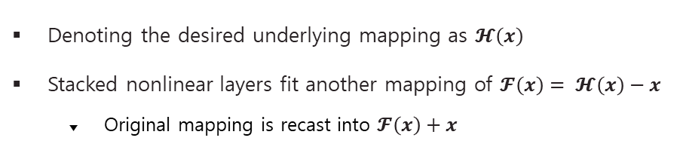
Model
Shortcut connections(residual network)
Denoting the desired underlying mapping as $𝓗\left(x\right)$
Stacked nonlinear layers fit another mapping of $𝓕\left(x\right)= 𝓗\left(x\right)−x$
Original mapping is recast into $𝓕\left(x\right)+x$
Intelligence Networking and Computing Lab.

Slide 13
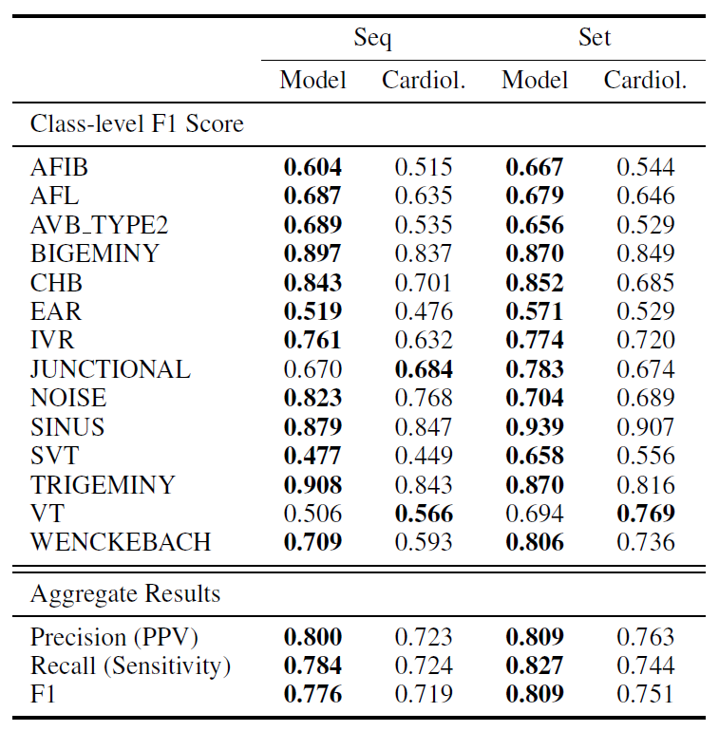
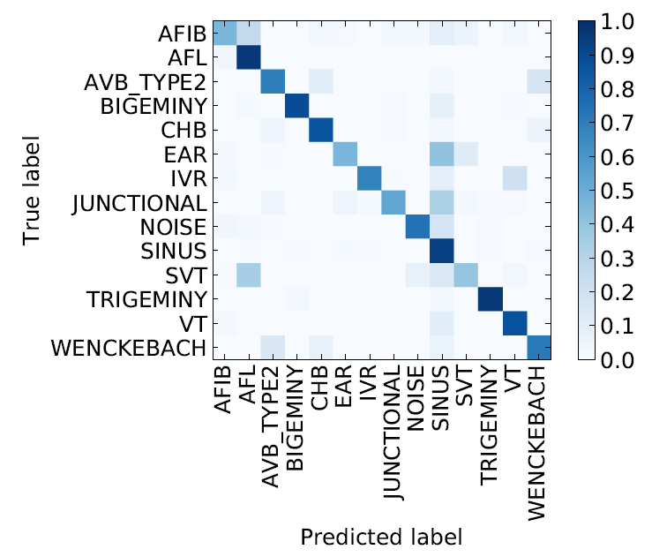
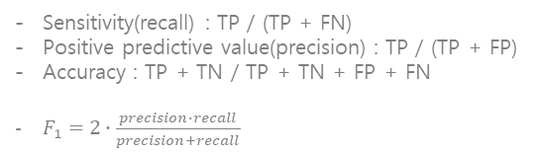
Analysis
Sensitivity(recall) : TP / (TP + FN)
Positive predictive value(precision) : TP / (TP + FP)
Accuracy : TP + TN / TP + TN + FP + FN
$F_{1}=2∙\frac{precision∙recall}{precision+recall}$
Intelligence Networking and Computing Lab.

Slide 14
I appreciate your deep interest
Intelligence Networking and Computing Lab.

